Slide 1
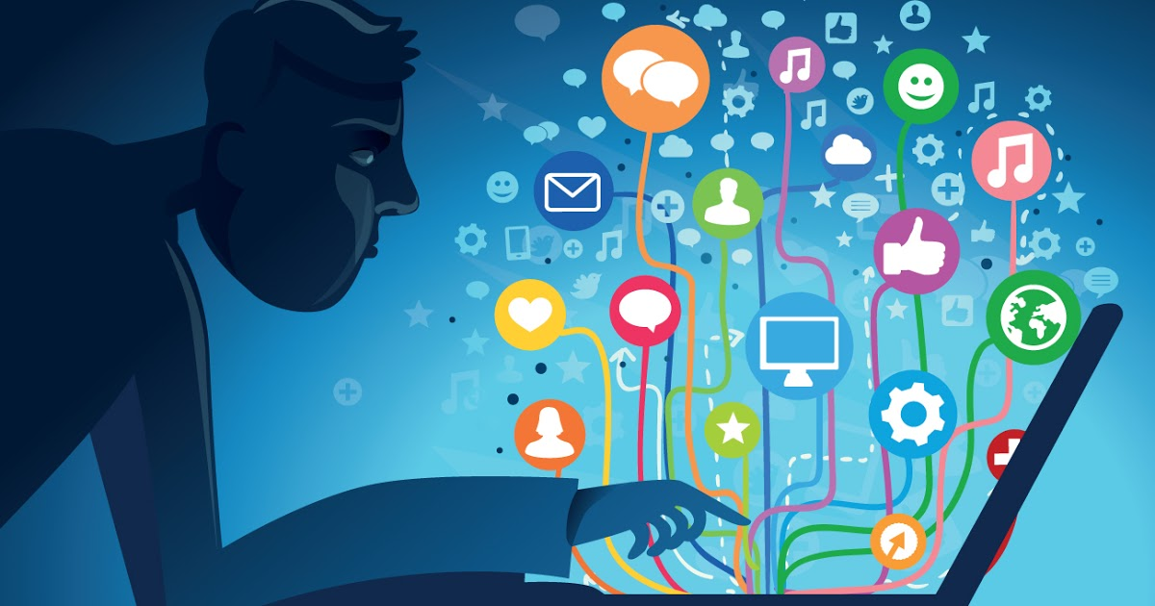

THE FOURTH INDUSTRIAL REVOLUTION AND THE INFLATION OF INFORMATION: ISSUES AND CHALLENGES
Assoc. Prof. Dr. Sonny Zulhuda
Ahmad Ibrahim Kulliyyah of Laws
International Islamic University Malaysia

Slide 2
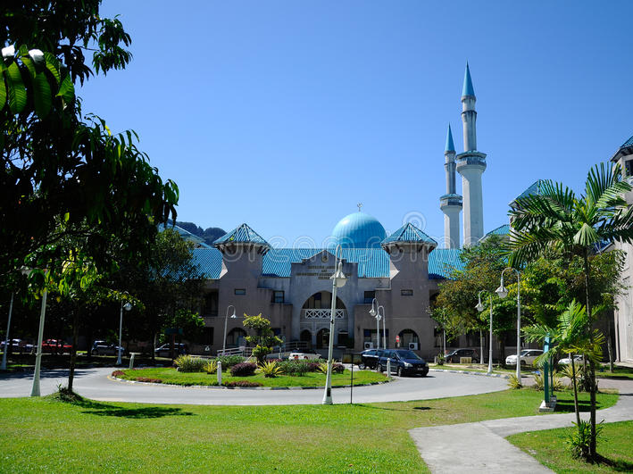
Information can bring people together or drive them apart. Sharing false information, or fake news, is divisive.
Judith Donath (2016)

Slide 3
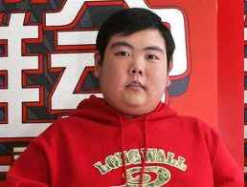
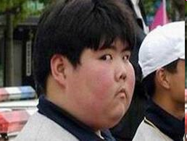
Meet Qian Zhijun of Shanghai…
"I felt awful when I found my picture edited into different images"

Slide 4
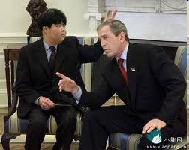
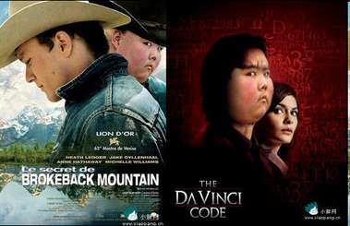

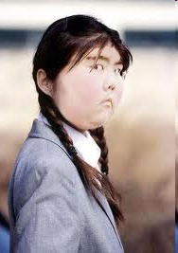

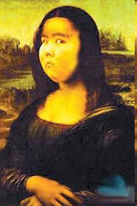
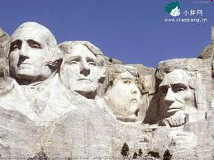


Slide 5
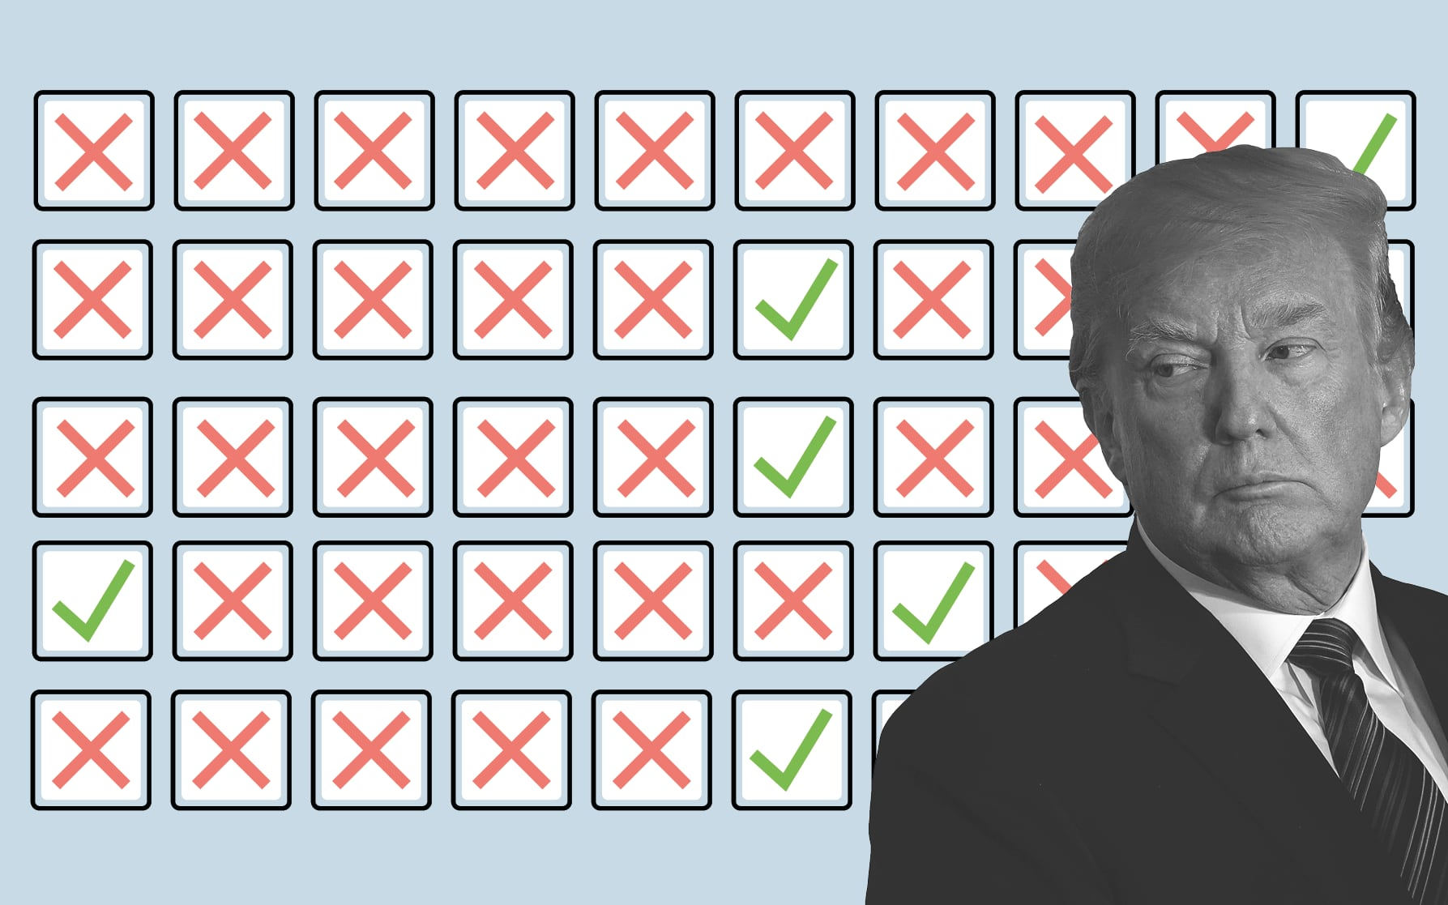
FAKE NEWS!

Slide 6
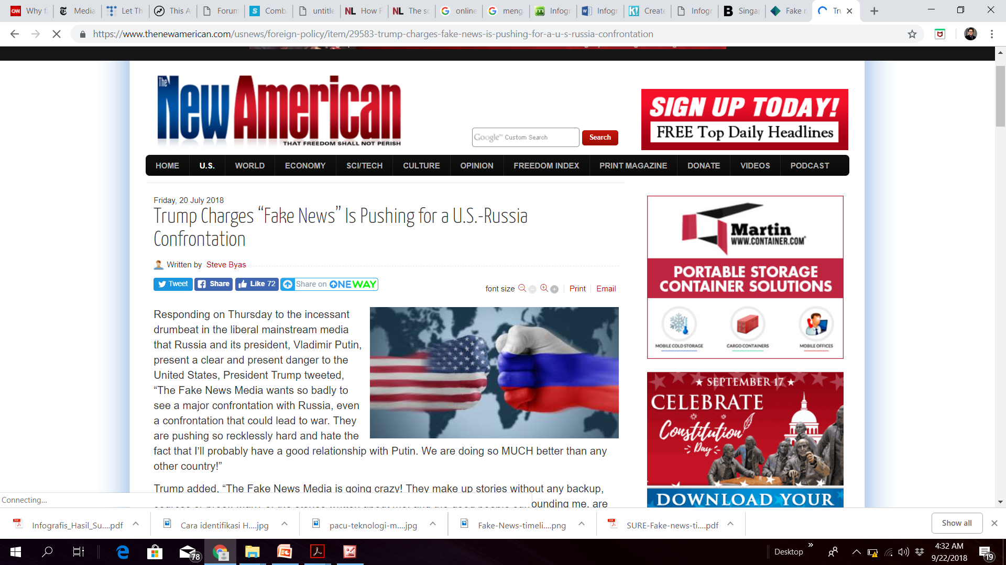

Slide 7
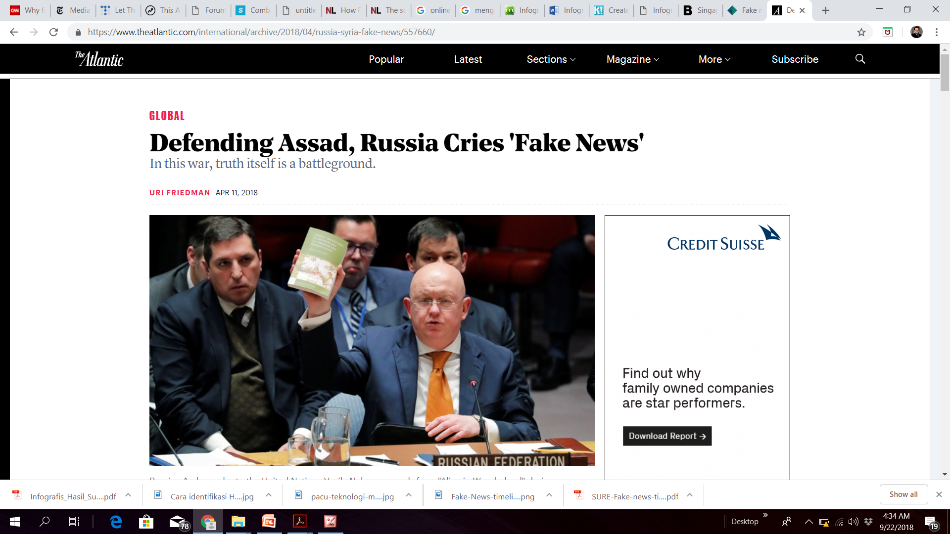

Slide 8
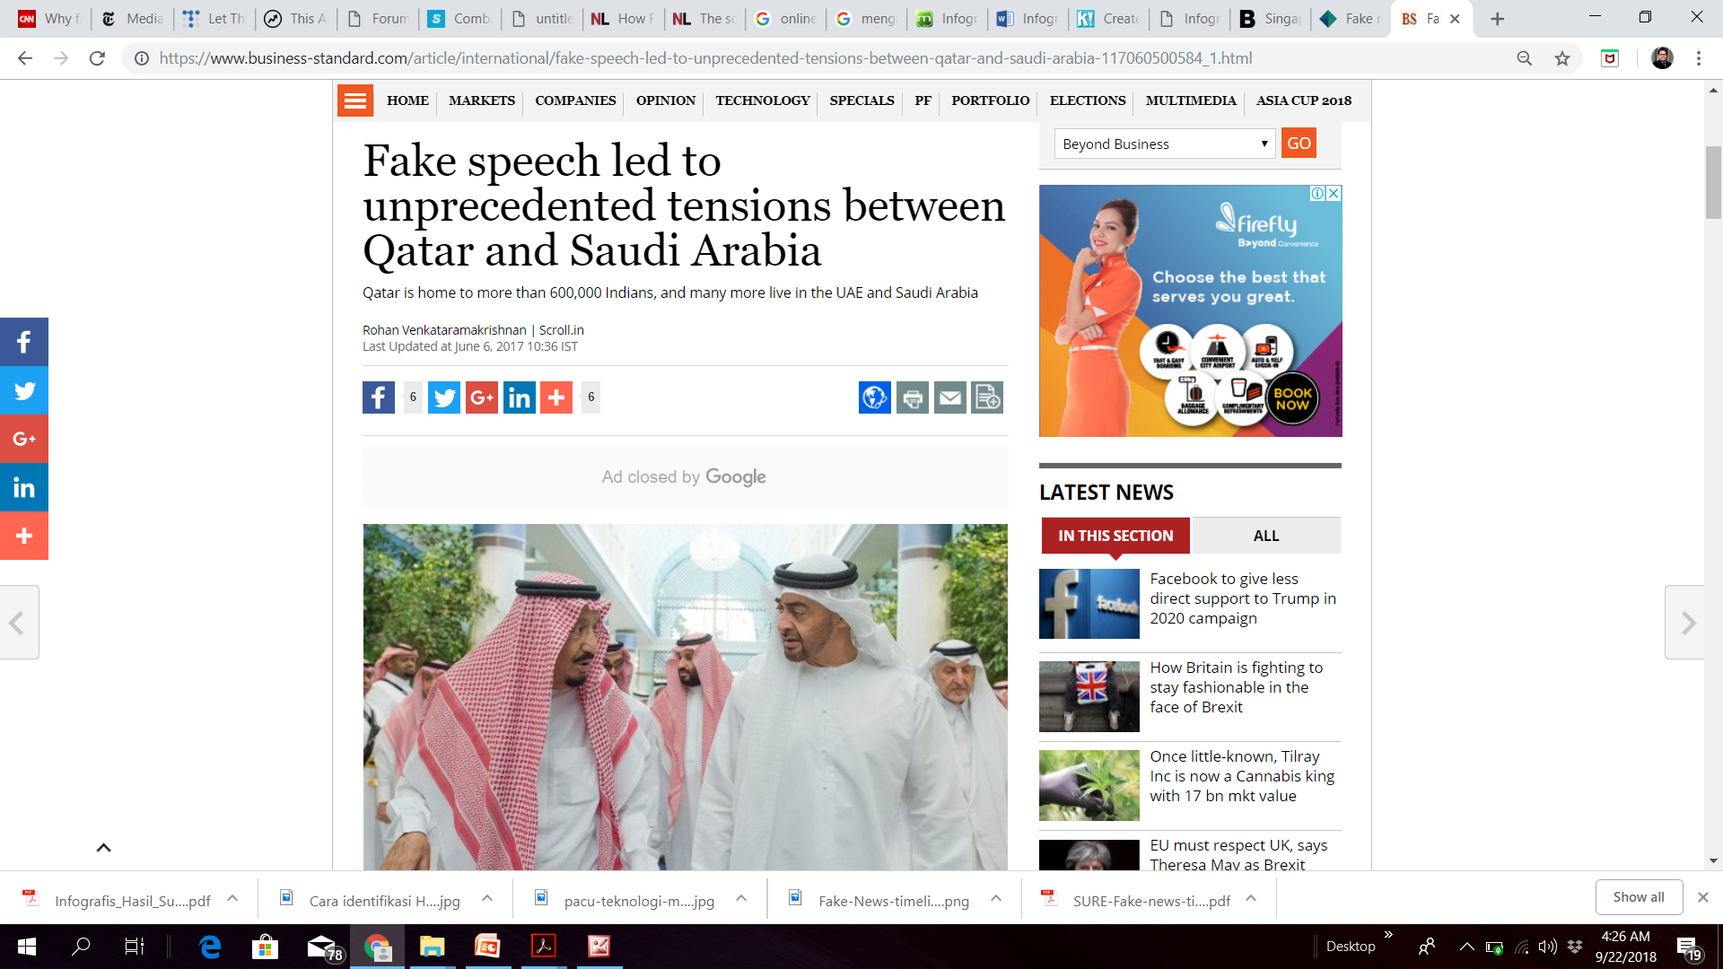

Slide 9
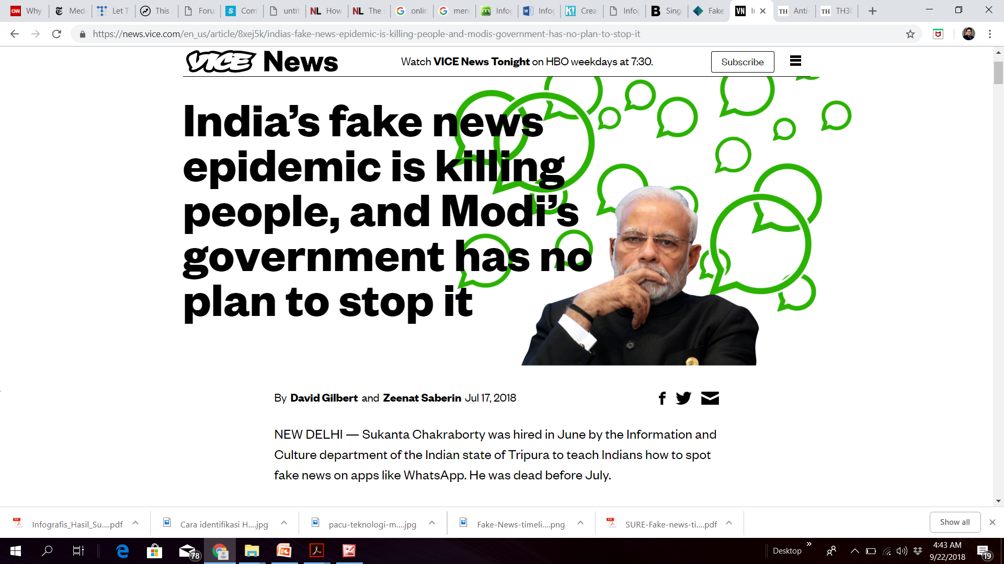

Slide 10
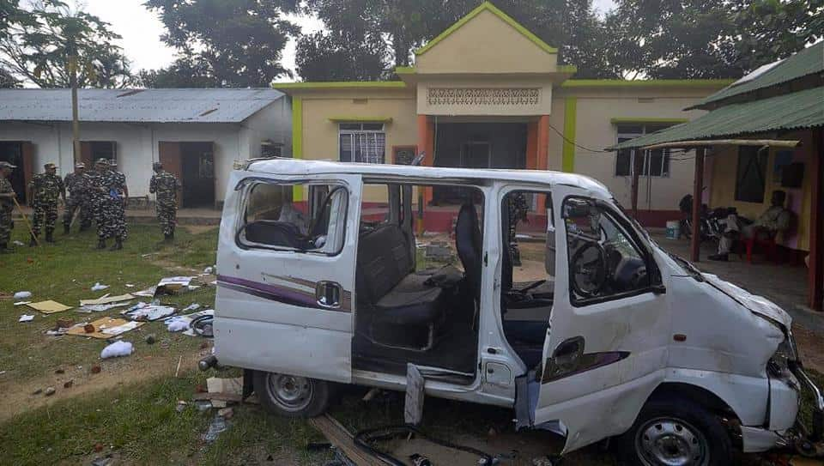
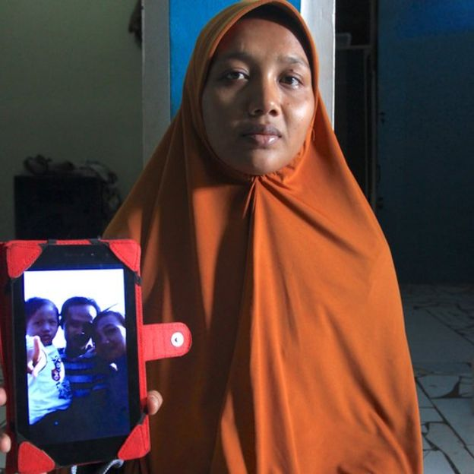
People were killed by mob in India and Indonesia due to a fake news

Slide 11
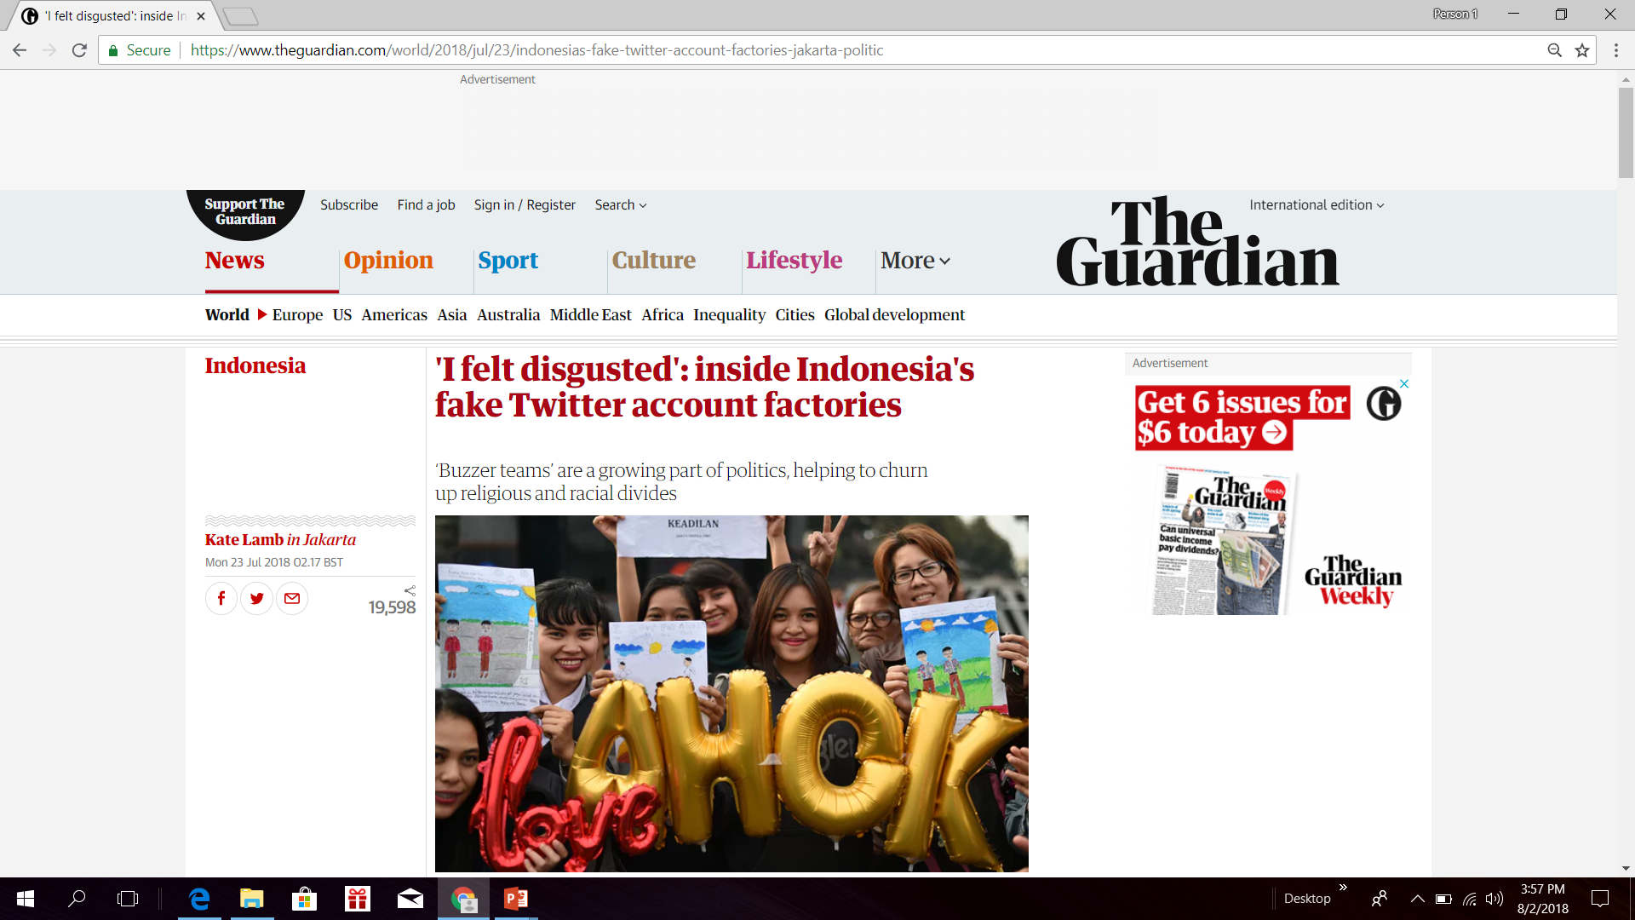
Fake news spread by fake accounts…

Slide 12
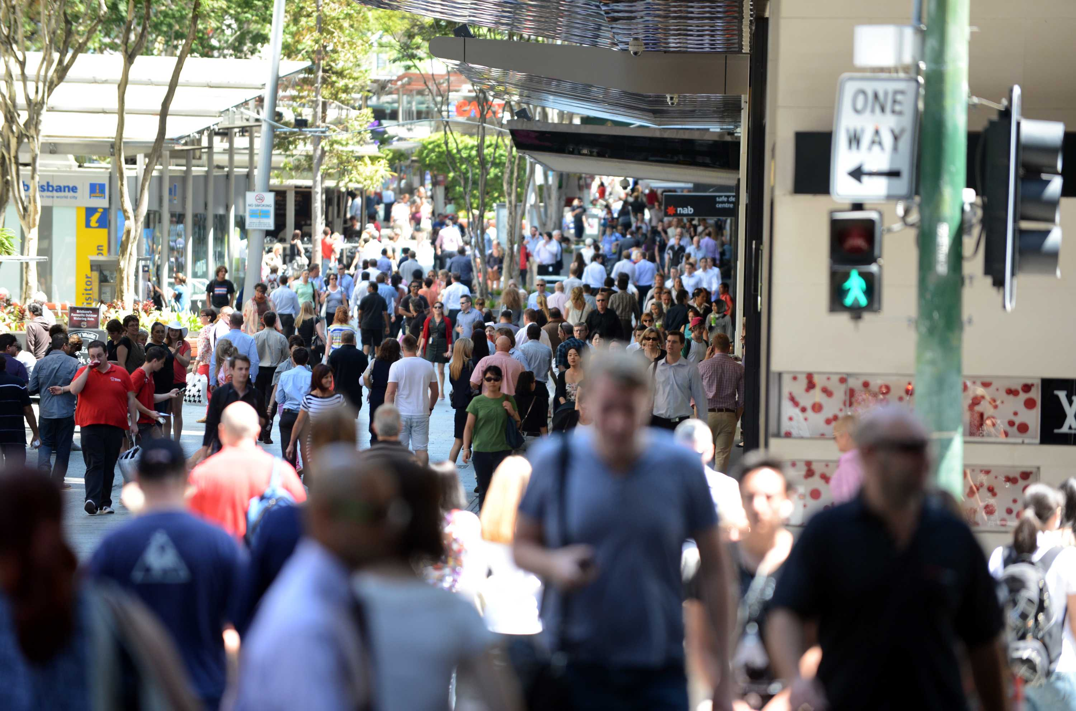
INDUSTRIAL REVOLUTION 4.0
Convergence of information technology and big data
A “disrupted society” - Connected, Interconnected and Over-connected

Slide 13
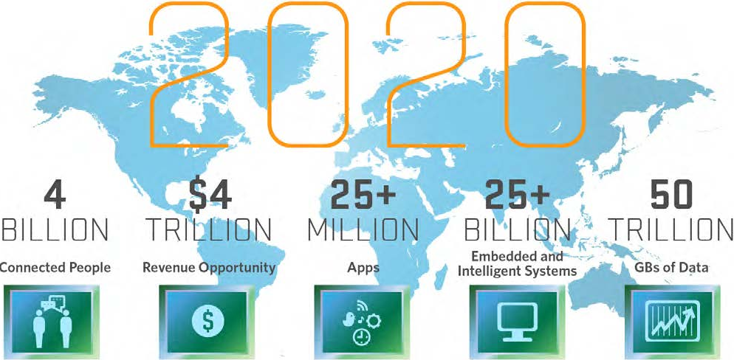
THE INTERNET OF THINGS

Slide 14
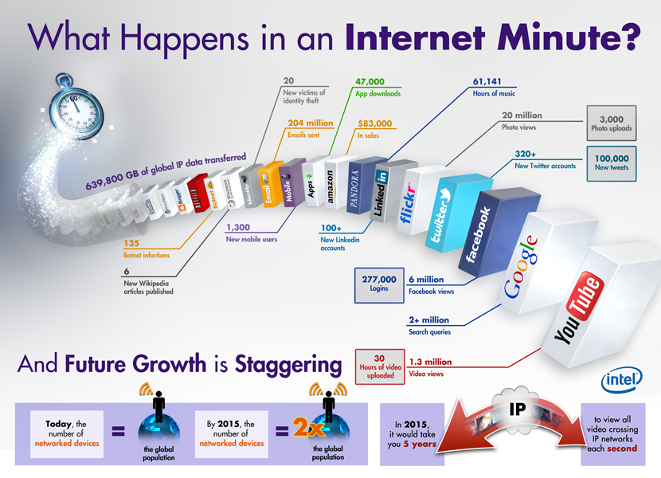

Slide 15
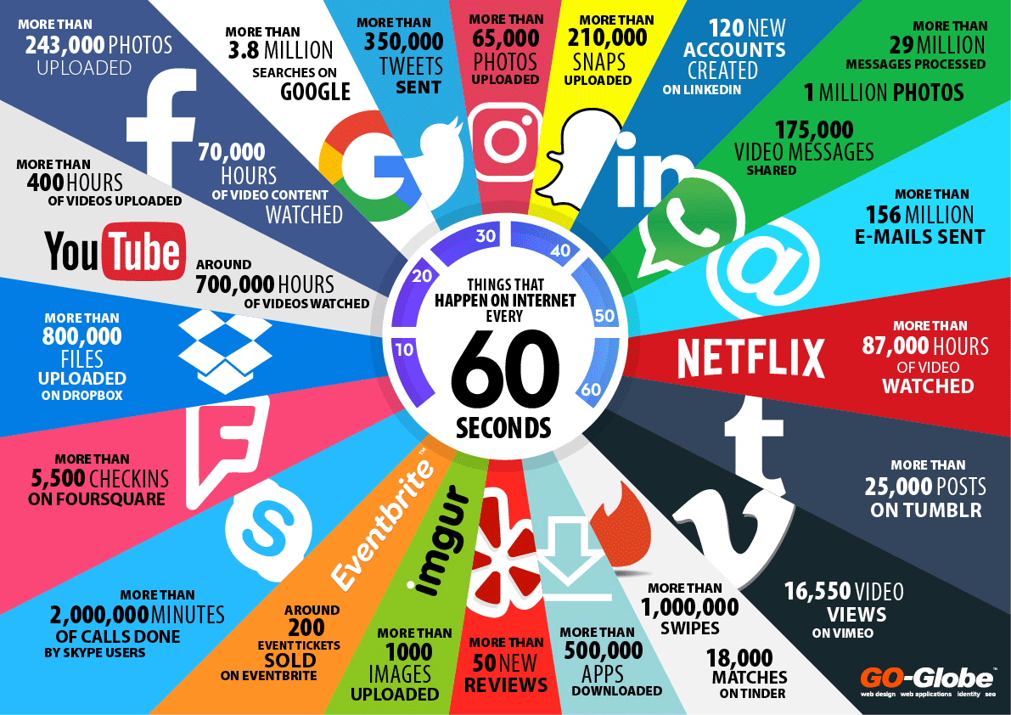
ONE MINUTE IN THE INTERNET

Slide 16
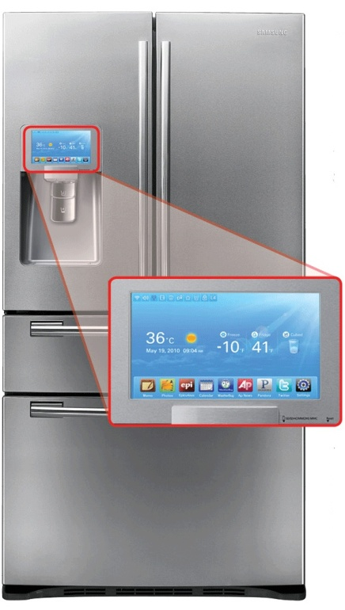
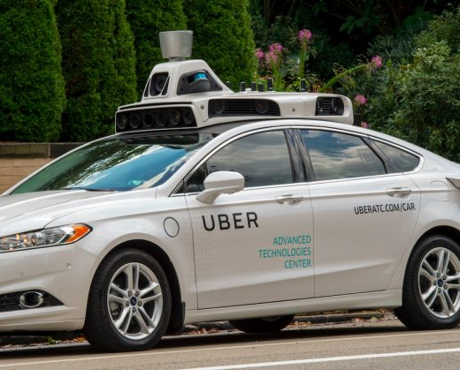
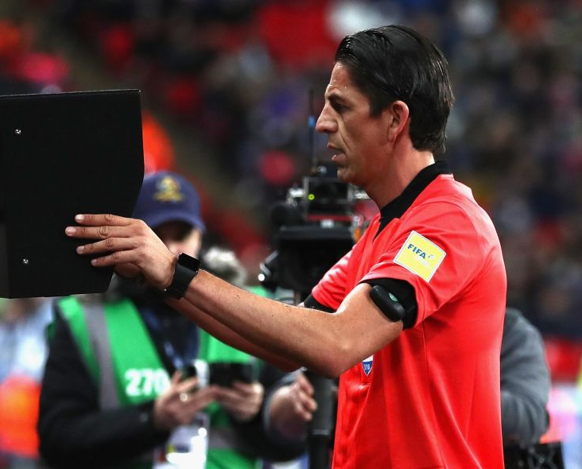
Use of artificial intelligence for innovation and economic development
(1) Smart Fridge;
(2) VAR at the World Cup 2018;
(3) Driver-less Uber car

Slide 17
INDUSTRIAL REVOLUTION 4.0
Excess of data inflation (Information Euphoria)
  More data gathering, less data intelligence?
  Smart phone, not-so-smart person?
  Information, disinformation, mal-information, misinformation

Slide 18

WHAT FAKE NEWS?
Bias:
Clickbait:
Lie:
Fake news:
Hoax:
A plan to deceive someone,
such as telling the police there is a bomb somewhere when there is not one, or a trick.
False stories that appear to be news
usually created to influence political views.
an ad or headline that entices the user to click for more information.
the link is there merely to generate ad income.
supporting or opposing a particular person or thing in an unfair way,
allowing personal opinions to influence your judgment.
Something you say
that you know is not true.

Slide 19
WHAT FAKE NEWS?
Internet troll:
Junk Journalism:
Disinformation:
Malinformation:
Misinformation:
Parody:
An individual who posts false accusations or inflammatory remarks on social media
to promote a cause or to harass someone.
A news story that is written without adequate research,
…investigation or information before publication.
Information that is based on reality,
used to inflict harm on a person, organization or country.
Wrong information,
or the fact that people are misinformed.
Writing, music, art, speech, etc. that intentionally copies the style of someone famous or copies a particular situation,
making the features or qualities of the original more noticeable in a way that is humorous.
with the deliberate intention to deceive.
Information that is spread

Slide 20
WHAT FAKE NEWS?
Post-truth:
Propaganda:
Rumour:
Satire:
Yellow journalism:
An adjective ‘relating to circumstances in which objective facts are less influential in shaping public opinion
than appeals to emotion and personal belief’.
Information, ideas, opinions, or images, often only giving one part of an argument,
spread with the intention of influencing people’s opinions.
An unofficial interesting story or piece of news that might be true or invented,
and quickly spreads from person to person.
Writing or art designed to make social commentary
based on mockery and imitation of real-life events or actors.
presents little or no legitimate or well researched news,
employing eye catching, clickbait headlines, with the sole intention of selling more newspapers and/or advertising space.

Slide 21
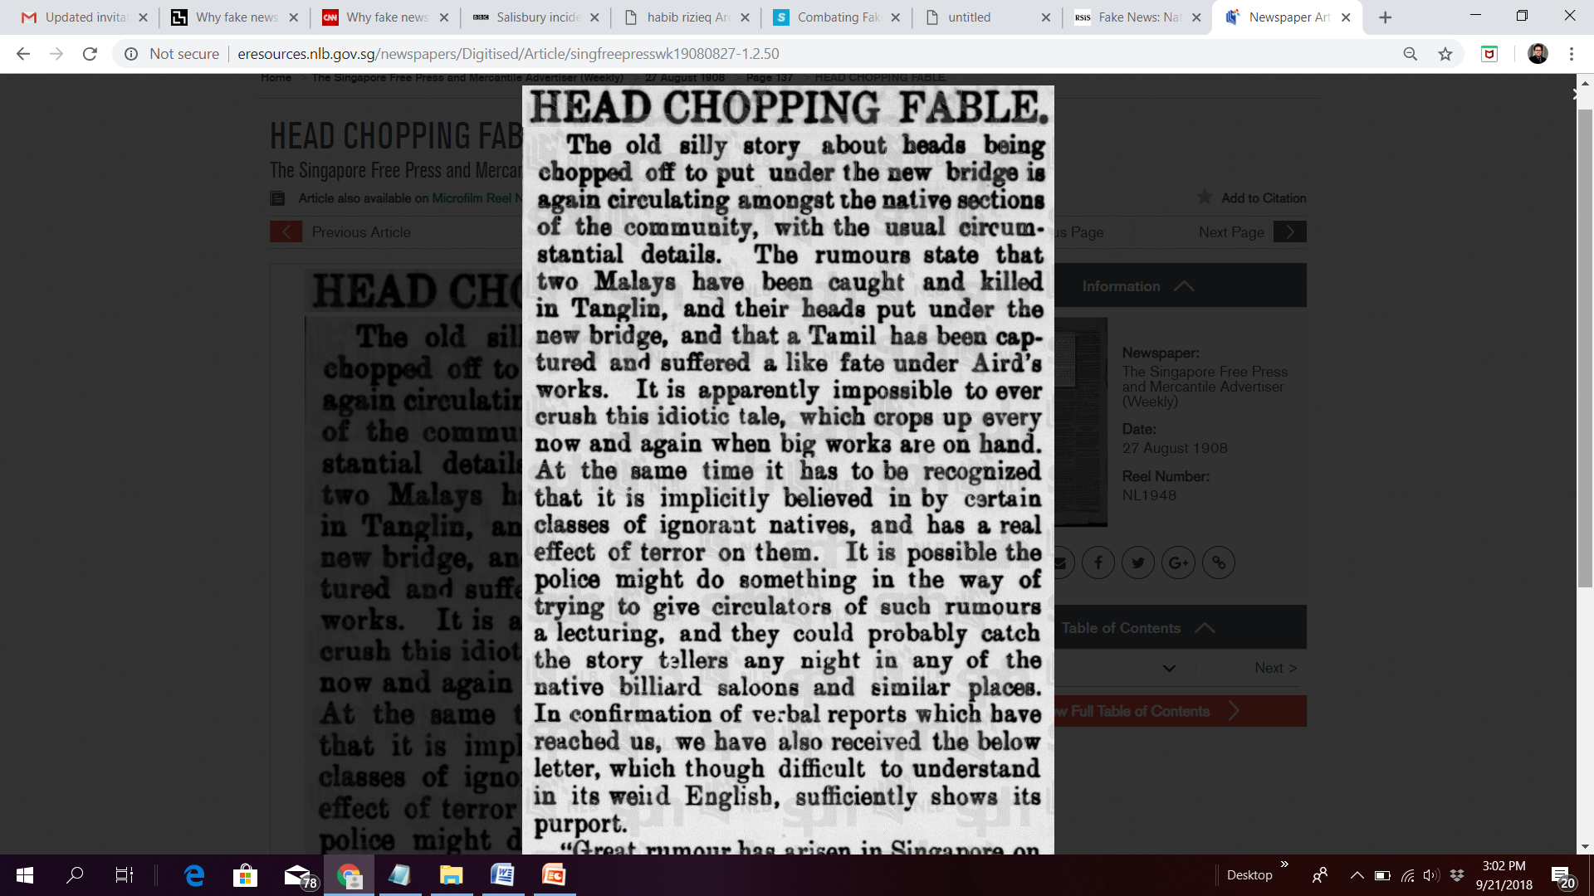
The Singapore Free Press and Mercantile Advertiser (Weekly), 27 August 1908, Page 137. Source: http://eresources.nlb.gov.sg

Slide 22
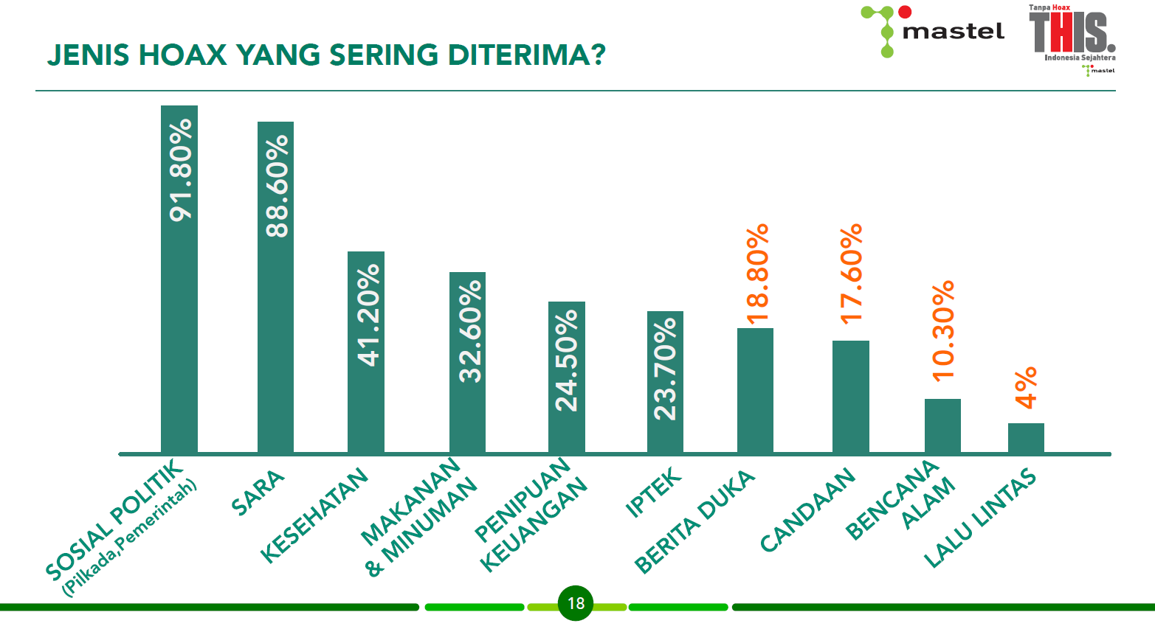
CONTENT OF HOAXES: Socio-political; Inter-racial issue; Health; Food and Beverages; Financial fraud; Scientific; Mourning news; Jokes; Natural disaster; Traffic news (Mastel, 2018)

Slide 23

Why sharing fake news is so appealing?
Partisanship: conforms to their existing beliefs!
Identity: proclaiming taste and affiliation
Dramatisation: fear factor
Naivety: to all that glitters
Self actualisation: Info superiority

Slide 24
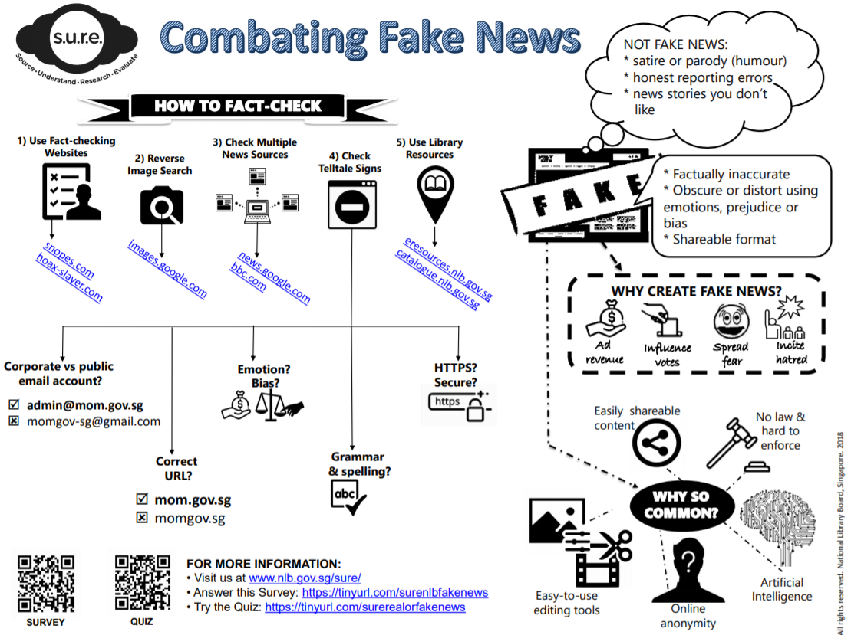

Slide 25
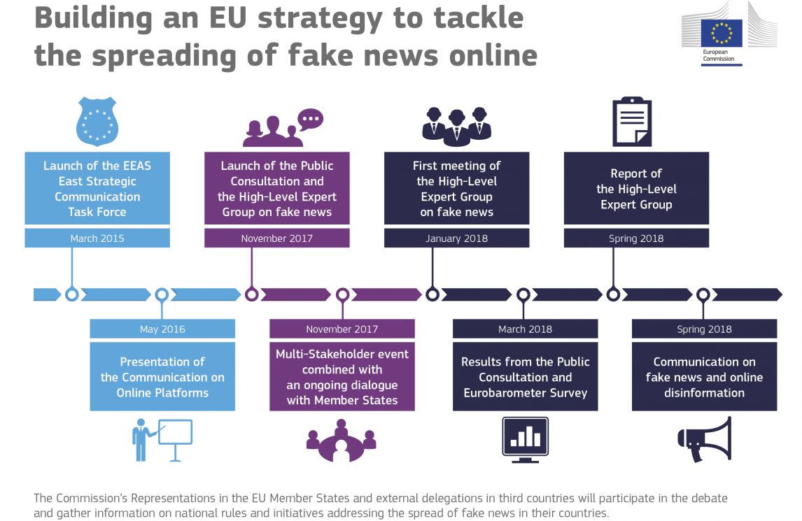

Slide 26
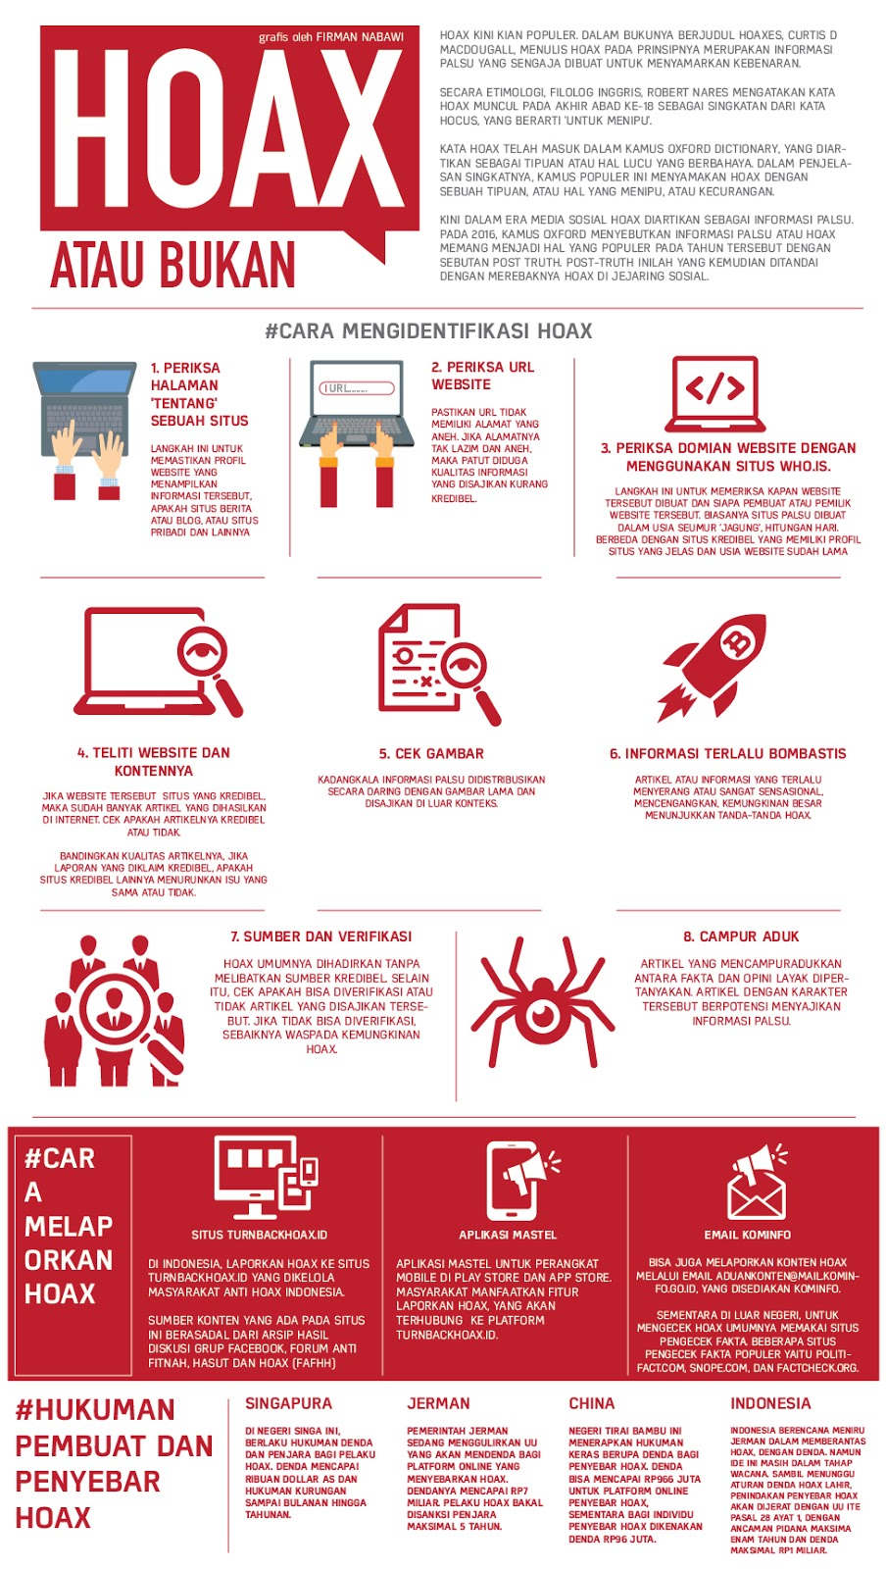
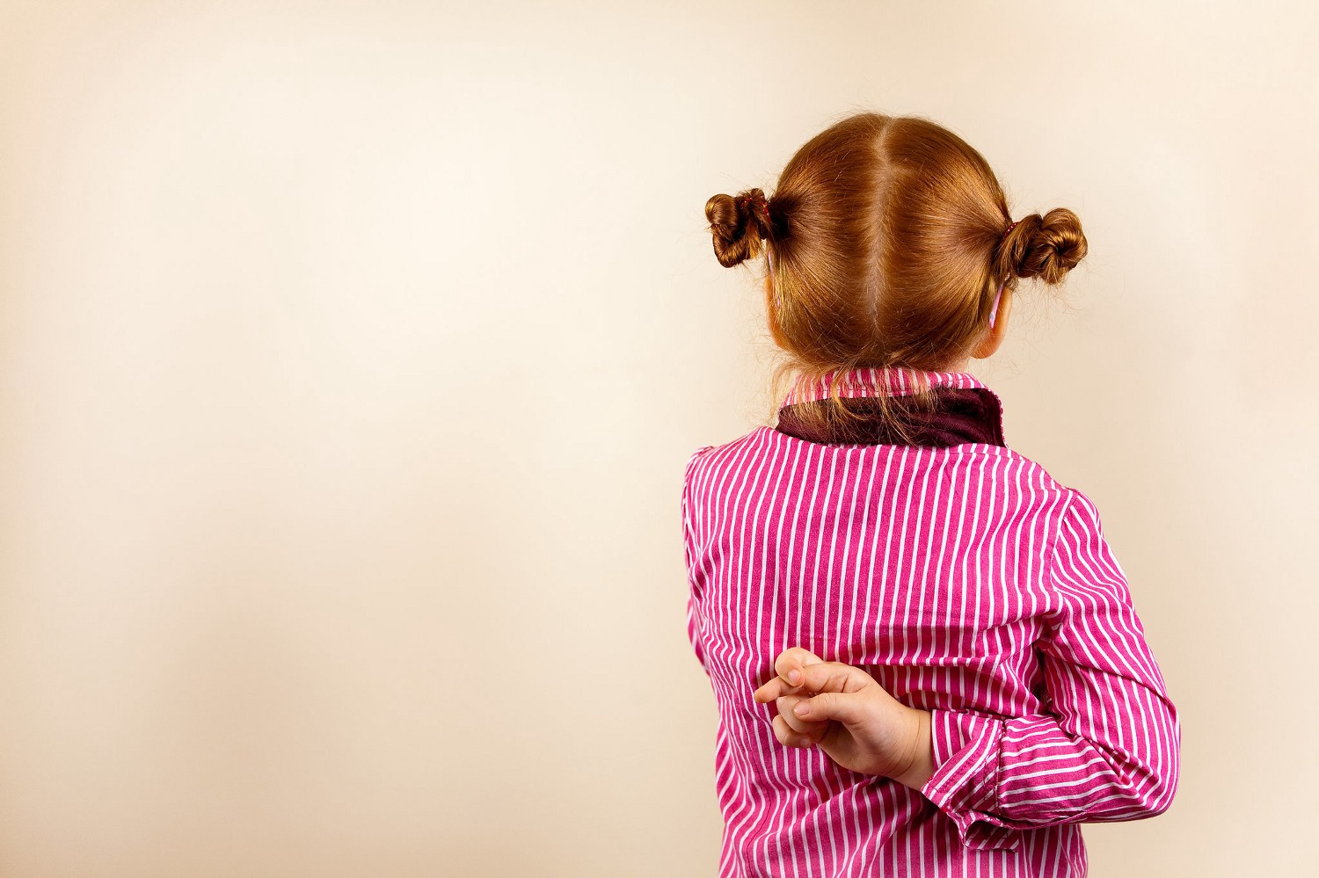

Slide 27
INDUSTRIAL REVOLUTION 4.0
Back to basic: Information culture and information governance
What regulates hoaxes?

Slide 28
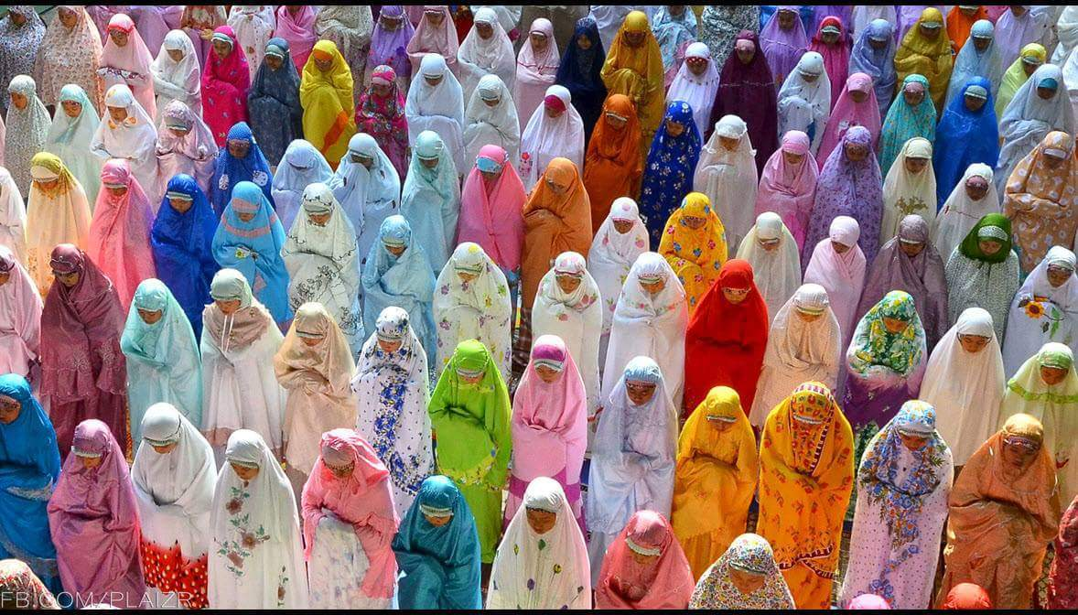
A WELL-INFORMED SOCIETY…
Information as a social infrastructure
Information as a political prerequisite
Information as a commercial lifeblood

Slide 29
Declaration of Principles: Building the Information Society
The Information Society should respect peace and uphold the fundamental values of freedom, equality, solidarity, tolerance, shared responsibility, and respect for nature.
We acknowledge the importance of ethics for the Information Society, which should foster justice, and the dignity and worth of the human person. Emphasis on the role of family in society.
The use of ICTs and content creation should respect human rights and fundamental freedoms of others, including personal privacy, and the right to freedom of thought, conscience, and religion.
All actors in the Information Society should take appropriate actions and preventive measures, as determined by law, against abusive uses of ICTs.
The World Summit on the Information Society 2003-2005 (ITU)

Slide 30
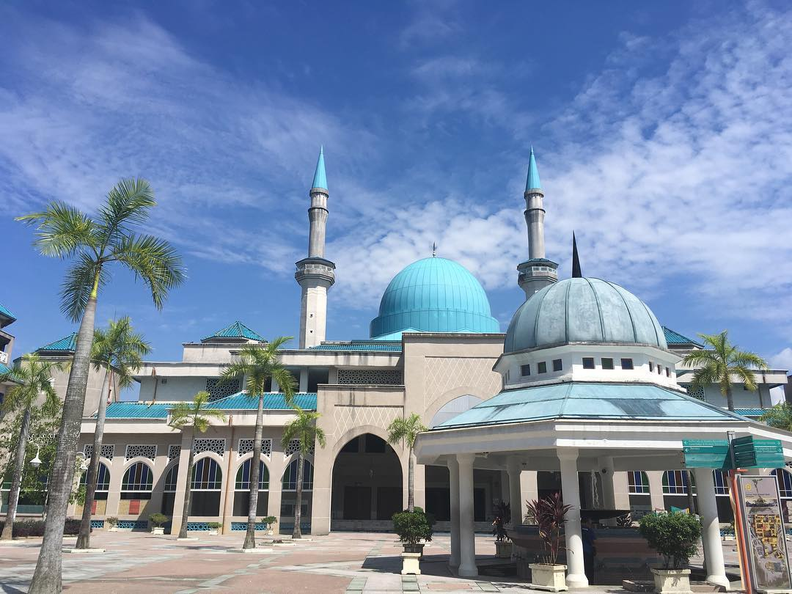
PROPHET-GUIDED INFORMATION GOVERNANCE
Info Dissemination: Emphasis on accuracy and clarity
Info Gathering: Assigns specialist to gather espionage
Info Management: Appoints secretaries among Companions
Info Confidentiality: Classified info on warfare, critical project e.g. Hijra, names of munafiqun.
Respects Privacy: Prohibits private surveillance
Info Authenticity: Uses special seal
Info Verification: Emphasises on Tabayyun

Slide 31
وَلا تَقْفُ مَا لَيْسَ لَكَ بِهِ عِلْمٌ إِنَّ السَّمْعَ وَالْبَصَرَ وَالْفُؤَادَ كُلُّ أُولَئِكَ كَانَ عَنْهُ مَسْئُولا
“And do not pursue that of which you have no knowledge. Indeed, the hearing, the sight and the heart - about all those [one] will be questioned.”
Al-Isra’ (XVII): 36

Slide 32
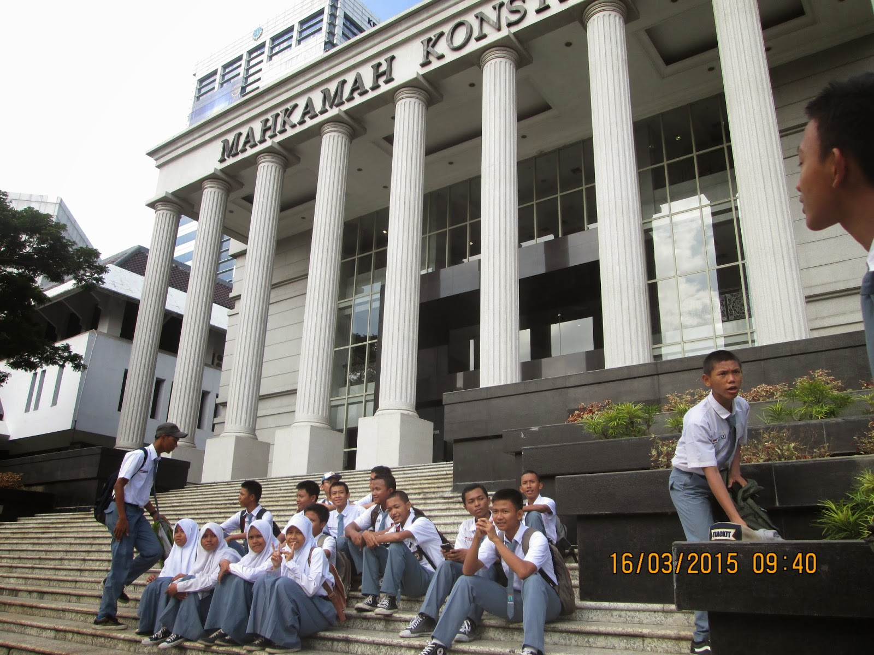
ROLE OF REGULATION IN CURBING HOAXES
Four modalities on regulating fake news/hoaxes:
  Law: Laws, Statutes, Courts, Bylaws
  Norm: Education, Religious approaches
  Market: Taxes, Bandwidth pricing
  Architecture: Hardware, Software
Legislative Approaches
  Prohibits Content
  Regulates Sharing
  Take-down Approach
  Regulating the Intermediaries

Slide 33

Information can bring people together or drive them apart. Sharing false information, or fake news, is divisive.

Slide 34
THANK YOU
FEEDBACK:
sonny@iium.edu.my
http://sonnyzulhuda.com

