Slide 1

EDUCATION TOWARD SOCIETY 5.0
ASEAN MODEL
Asep Saefuddin
Rector of University of Al Azhar Indonesia
Professor of Statistic
October 25th 2019

Slide 2
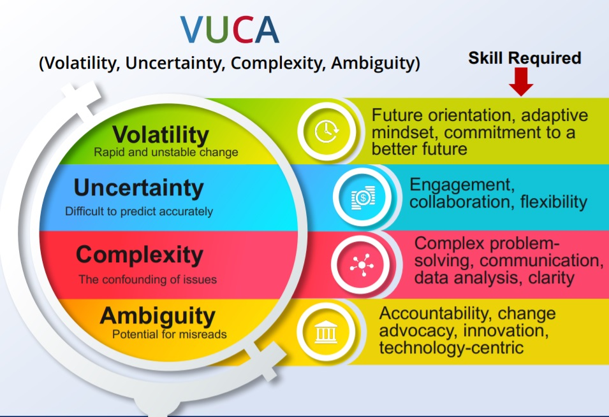
BANGUNAN MUTU UAI

Slide 3














Digital Workplace Activities
Sharing economy
e-Education
e-Government
Cloud Collaborative
Marketplace
Online Health Services
Smart Manufacturing
Smart City
Smart Appliances

Slide 4
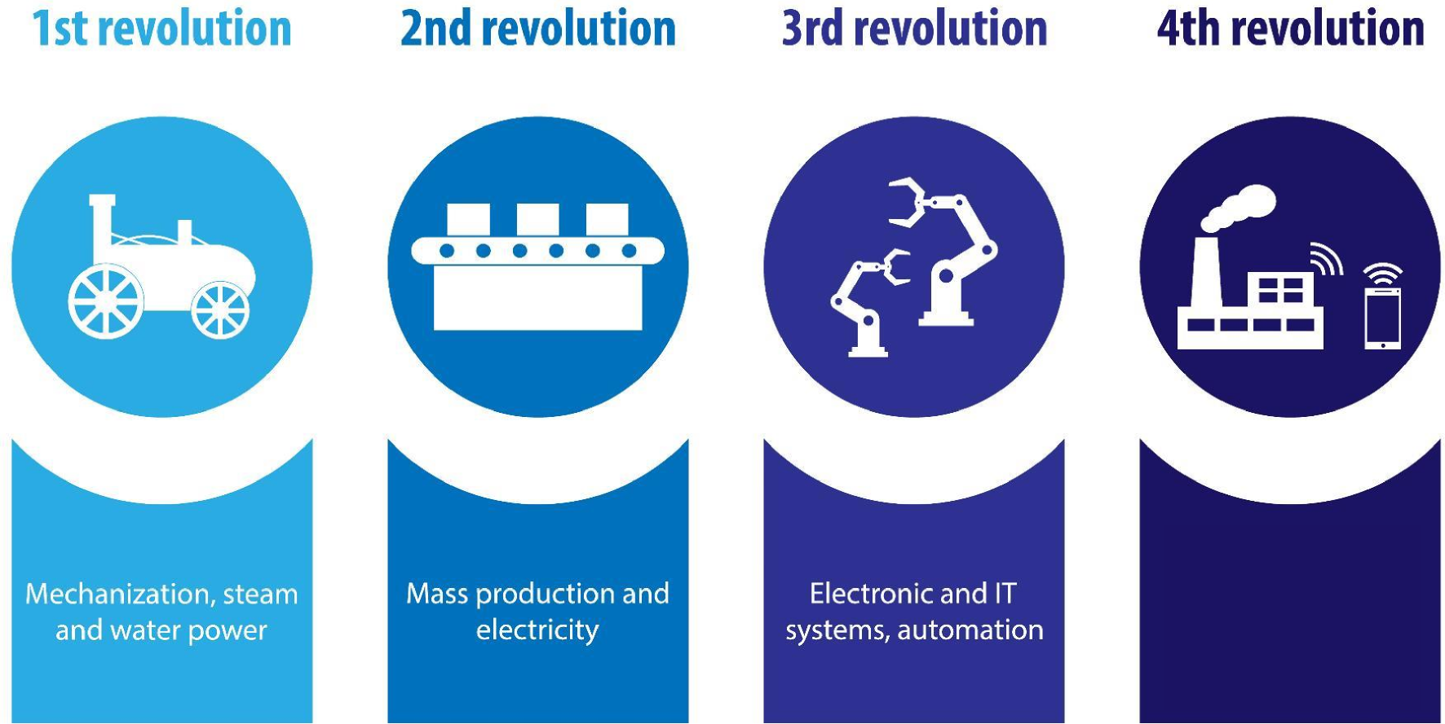
... INDUSTRIAL REVOLUTION ...
Cyber Physical
System, Internet of
Things & Bio-
technology

Slide 5
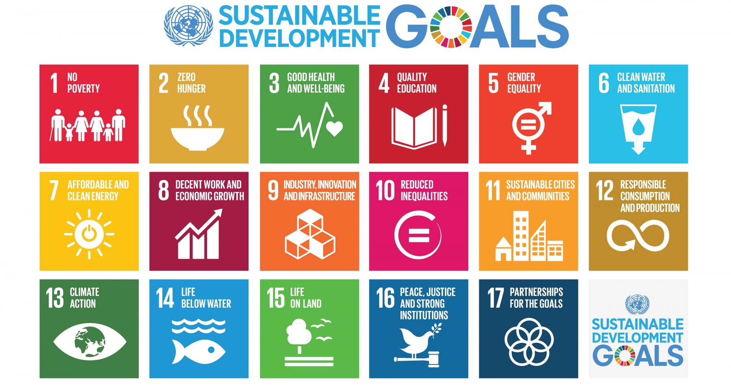

Slide 6
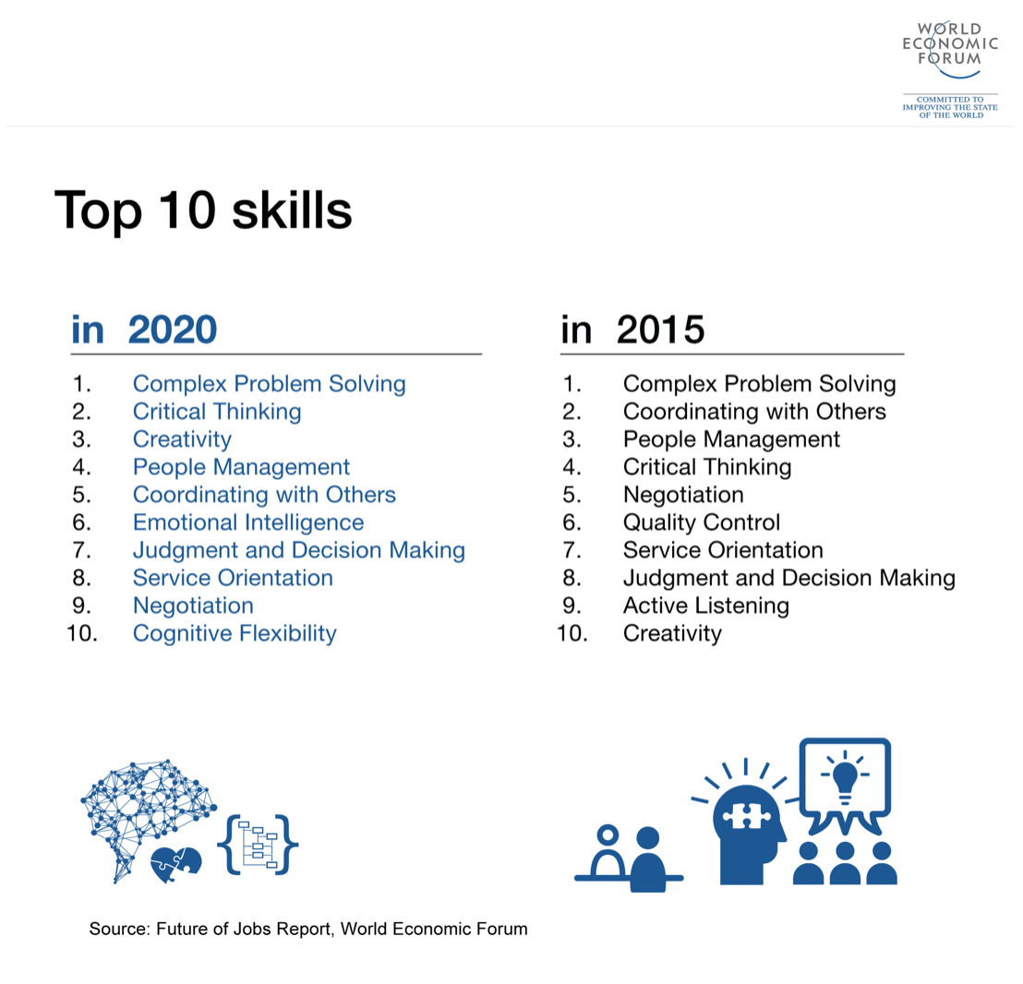
TOP 10 SKILLS : SOCIETY 5.0
GRIT: PASSION & PERSERVERANCE

Slide 7
Sharing Knowledge, Science and Technology
Sharing Experience (Lesson Learn)
ASEAN Model Society 5.0
ASEAN as A Leader Toward Peaceful Modern Society
ROADMAP : ASEAN SOCIETY

Slide 8
CHARACTER
ASEAN society collaboration orientation
KNOWLEDGE
Sharing knowledge, Science and Technology
Sharing experience
SKILL
Environmentally friendly technology

Slide 9
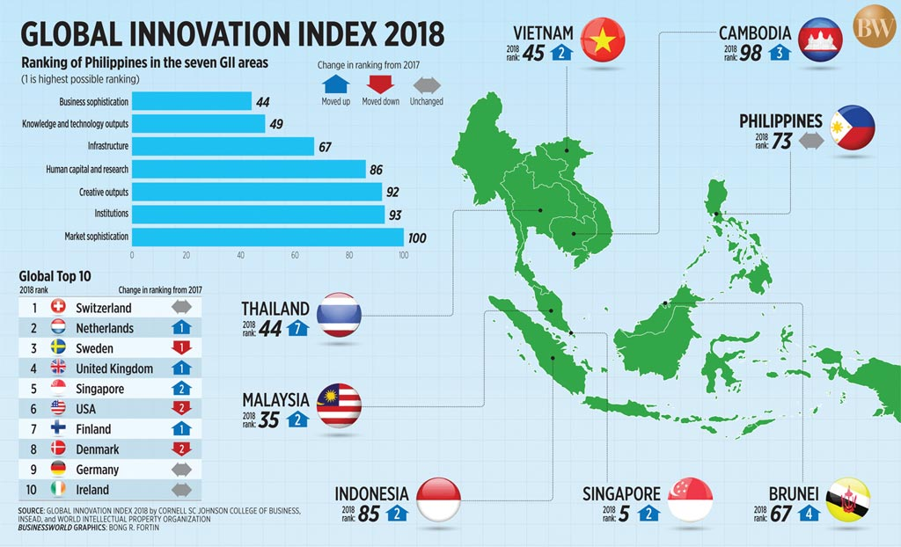

Slide 10
RECOMMENDATION
HUMANITY
COLLABORATIVE MINDSET
RESPECTFUL NATIONALITIES

Slide 11

JAZAKUMULLAH

