Slide 1

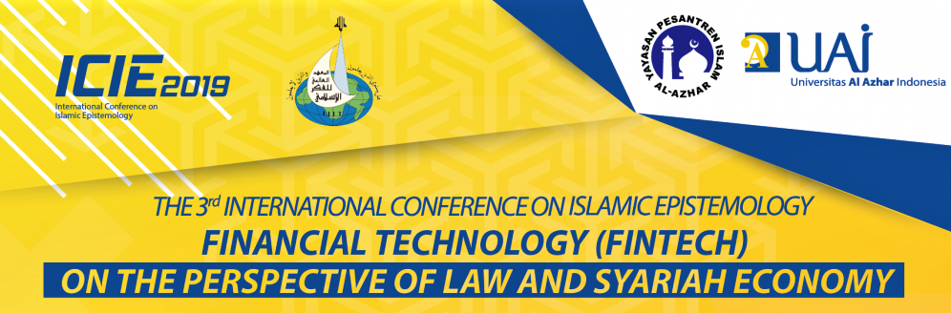
FINANCIAL TECHNOLOGY REGULATED SYSTEM AND ITS BENEFIT FOR THE MASLAHAT OF UMMAH
DR SONNY ZULHUDA
ASSOCIATE PROFESSOR at AHMAD IBRAHIM KULLIYYAH OF LAWS
INTERNATIONAL ISLAMIC UNIVERSITY MALAYSIA
Presented at the 3rd International Conference on Islamic Epistemology at Universitas Al-Azhar Indonesia, Jakarta, 8 October 2019

Slide 2

OUR LITTLE FINTECH JOURNEY TODAY
Looking at Fintech as Innovation
The role of Law vis a vis Innovation
Learning from mistakes in the past
Disruptive Law Approach
Develop the Roadmap
Big Data; Smart technology; Mobility
Maqasidic Perspective
Law as Carrier, not Barrier
4-Modalities by Lawrence Lessig
Engage not Restrict
Sonny Zulhuda (c) 2019

Slide 3
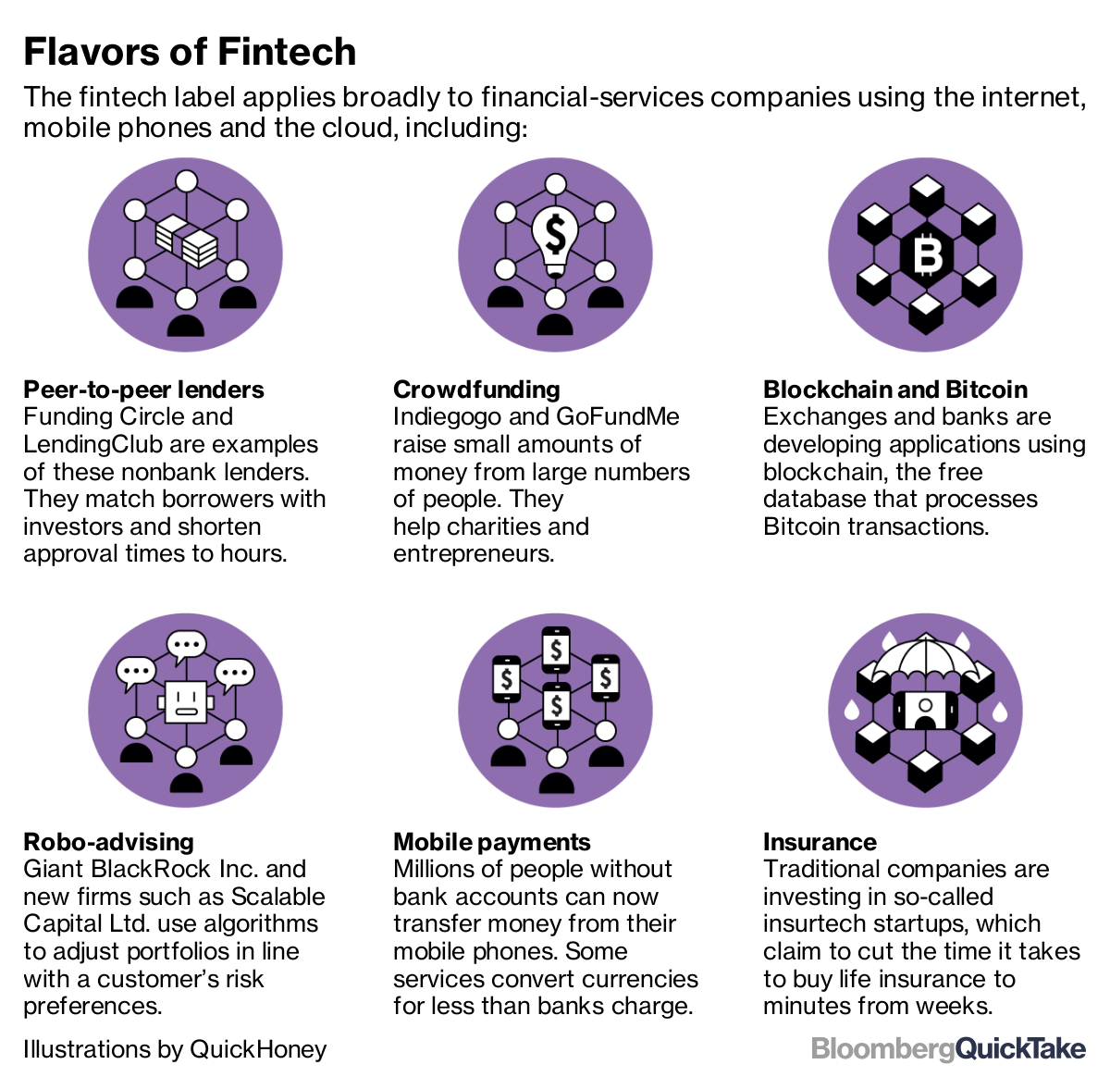
WHAT MAKES A FINTECH

Slide 4
WHAT MAKES A FINTECH
Synchronised (gadget, data, workplace)
Man-machine synergy
AI / Analytics (Big data)
Revolutionary
Targeted/Customised

Slide 5

WHAT MAKES A FINTECH
Fintech: FINANCE + TECHNOLOGY
The use of technology for a variety of financial services and products
An innovation in the making
  Innovation on worldly affairs in order to attain the pleasure of Allah SWT is encouraged in Islam
  Qur’an Chapter 55:33 – “O company of jinn and mankind, if you are able to pass beyond the regions of the heavens and the earth, then pass. You will not pass except by authority [from Allah ].”
Comes with Pros and Cons
  Maqasid view: Fintech from Hajjiyat to Doruriyat. Towards efficiency, inclusiveness and increased transparency
  Risks: In term of Data security, Data privacy and Issues of consumer protection
“Innovation is the ability to see change as an opportunity - not a threat”
(Steve Jobs)

Slide 6
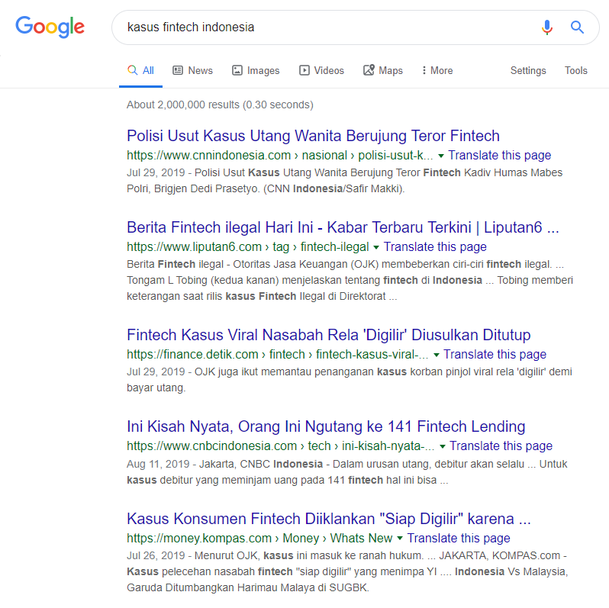
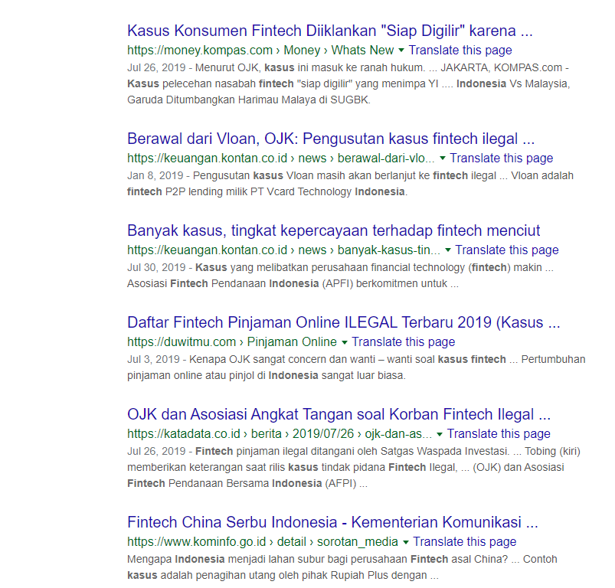
OUR “FINTECH” NEWS TODAY

Slide 7
What changes: Financial Services & Digitisation
With the financial industry moving towards digitisation, new dimensions of risk management have emerged.
  Datafication: Tendency to record not only the critical data, but also everything else.
  More gadget, more potential security breaches
  Same thief, new method!
  CIA of data security: Managing the confidentiality, integrity and availability of data
  Legal risks surrounding data : From reputation to financial detriments
“Datafication” – the process of quantifying all information around us: our location, movement, communications, usage of devices, etc. which will allow us to use such information in new ways, such as in predictive analysis. This will help us further to unlock the implicit, latent value of the information.
V. Mayer-Schonberger and K. Cukier (2013)
Big Data: A Revolution That Will Transform How We Live, Work and Think.
Sonny Zulhuda (c) 2019

Slide 8
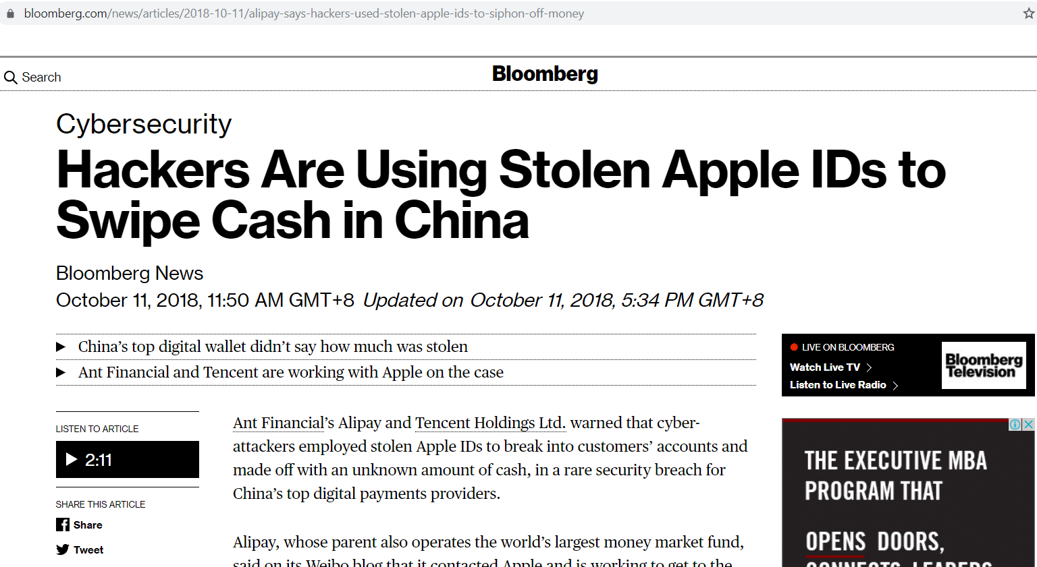
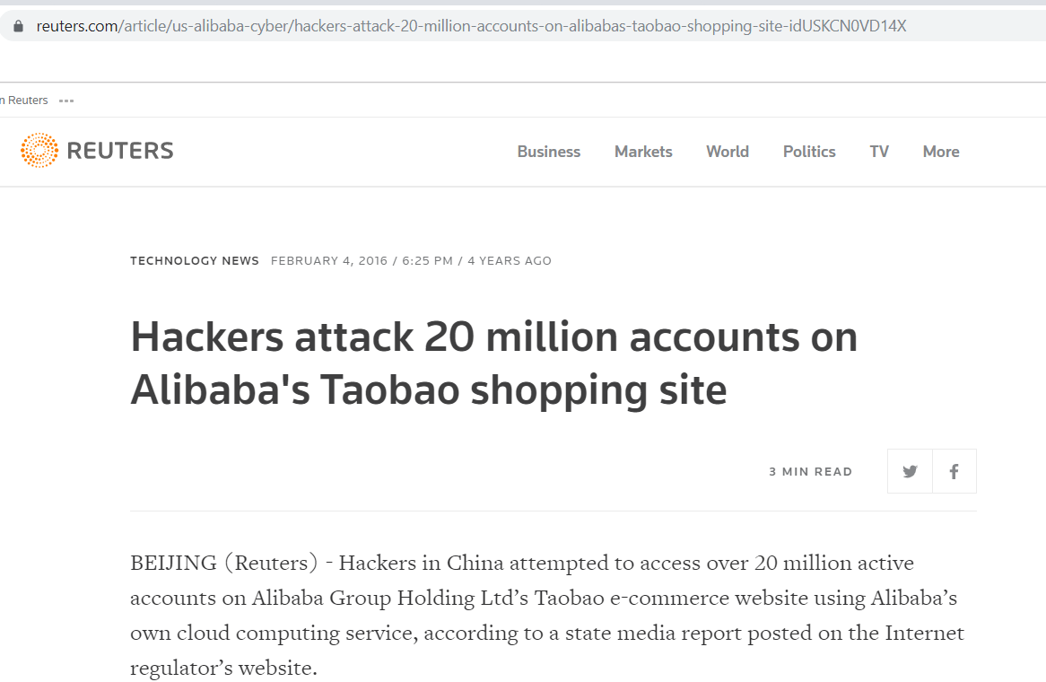
What remains: The NEED FOR financial integrity and consumer protection
Financial inclusion
Accessibility for all
Affordability
Technological adoption and adaptation
Financial integrity
Security of transaction
Security of data
Security of financial system
Consumer protection
Fraudsters
Industrial exploit
Right to privacy
Public security, social stability, economic resilience
Sonny Zulhuda (c) 2019

Slide 9

What law should do in the face of innovation
“Commercial Law” is not rules written on stone
  The law shall reflect the societal development
  Creates certainty in business
  Set up a correct expectation of social behaviour
  Rectify the wrongs in society
  Balances private and public objectives
Innovation is disruptive in nature
  A disruptive law is necessary
Sonny Zulhuda (c) 2019

Slide 10
Taking a disruptive approach: Disrupting the disruptives
Instead of writing a strict rule of the game in the form of law and regulation, it is necessary to look for a rather flexible approach. Follow these steps:
  Innovation does not work in legal vacuum: Define the existing legal framework that may help OR that may NOT help
  Regtech must be responsive to technologies while remaining technology-neutral!
  Learn from Mistakes in the past: E-Hailing service, Cryptocurrency, OTT, e-Shop, e-News
Consider all stakeholders (Multi-stakeholdersim)
Start with trust!
  In Malaysia, the Fintech Regulatory Sandbox (Sandbox) 2016 plays an important role in enabling the financial innovation can survive and sustain efficiently in a live environment. It also allows for a more targeted and efficient testing approach for high-impact innovations.
Consider all modalities on regulations at all time!

Slide 11

LET’S TALK!
“Are lawyers and information scientists speaking the same language?”
Longdin (2000)
Int J Law Info Tech.; 8: 1-24
“Lawyers and scientists will never speak the same language, but it should be possible for each to develop a better understanding of the principles and methods of the other profession.”
Kennedy & Merrill (2007)
The National Academies, Washington DC
“Today… one of the principal problems of legislation is… it is written by legislators. Legislators are not usually technocrats.. moreover, technocrats –while they may have some input into the process– do not enjoy a particularly prominent seat at the table when legislation is being created.”
Connoly (2004)
Law of Internet Security and Privacy
Sonny Zulhuda (c) 2019

Slide 12
FINTECH DOES NOT PLAY IN LEGAL VACUUM
Capital Markets and Services Act 2007
Central Bank of Malaysia Act 2009
Communications and Multimedia Act 1998
Electronic Commerce Act 2006
Financial Services Act 2013
Guidelines on Recognized Markets SC-GL/6-2015(R3-2019)
Capital Markets and Services (Prescription of Securities) (Digital Currency and Digital Token) Order 2019
Anti-Money Laundering, Anti-Terrorism Financing and Proceeds of Unlawful Activities Act 2001
Personal Data Protection Act 2010
Islamic Financial Services Act 2013
SME Tax Incentives by Craddle Fund, MDEC, etc
Computer Crimes Act 1997
Credit Reporting Agencies Act 2010
Fintech Regulatory Sandbox 2016
Penal Code
BNM Fintech
Regulatory
Sandbox 2016
Sonny Zulhuda (c) 2019

Slide 13

Lessigs’ 4-modalities approach in regulating fintech
Norm
Architecture
Market
Code/Law
Social values
Business objectives
Religiosity
Technical Standard
Apps specification
Data protection policy
Tax regime
Licensing regime
Incentives
Law & Regulation
Industrial Reg
Best practices

Slide 14
the blindspotS on FINTECH data governance
Fintech risks as blindspot: You know it’s there, but you don’t see it. It does not improve unless you make adjustment.
Blindspot #1: When too much is not good (data obesity)
Blindspot #2: Is it your data? Who’s the owner?
Blindspot #3: Delegate the task, not the responsibility
Blindspot #4: The enemy within
Sonny Zulhuda (c) 2019

Slide 15
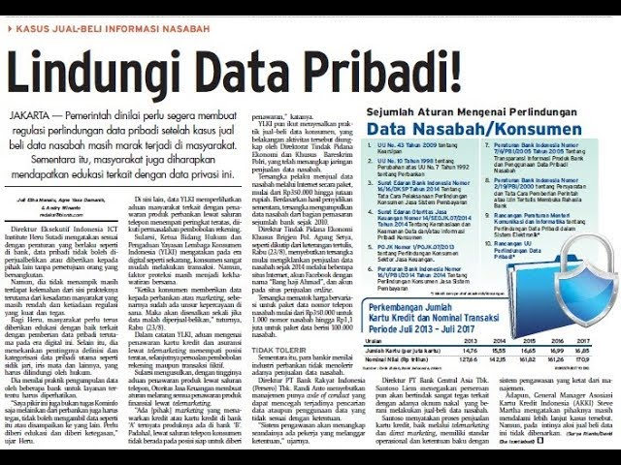

Slide 16
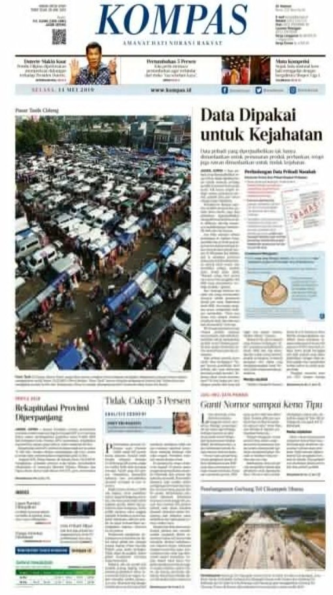

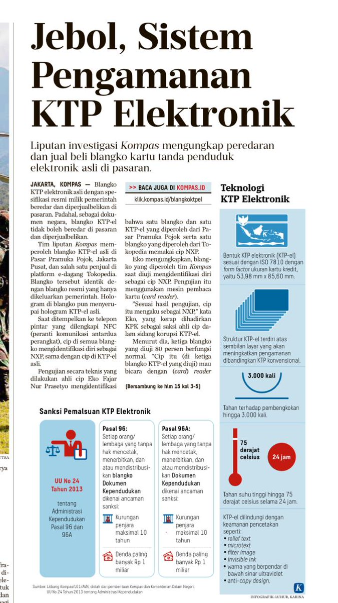

Slide 17
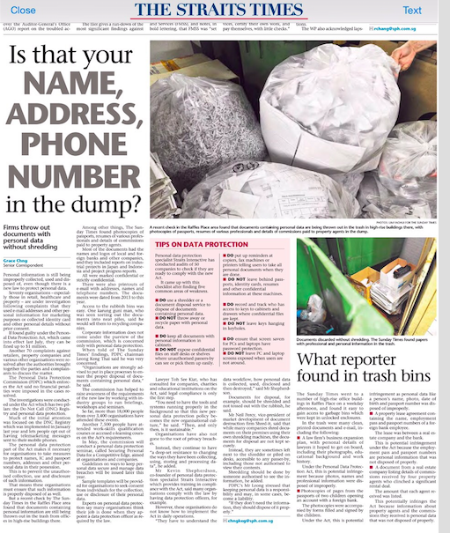
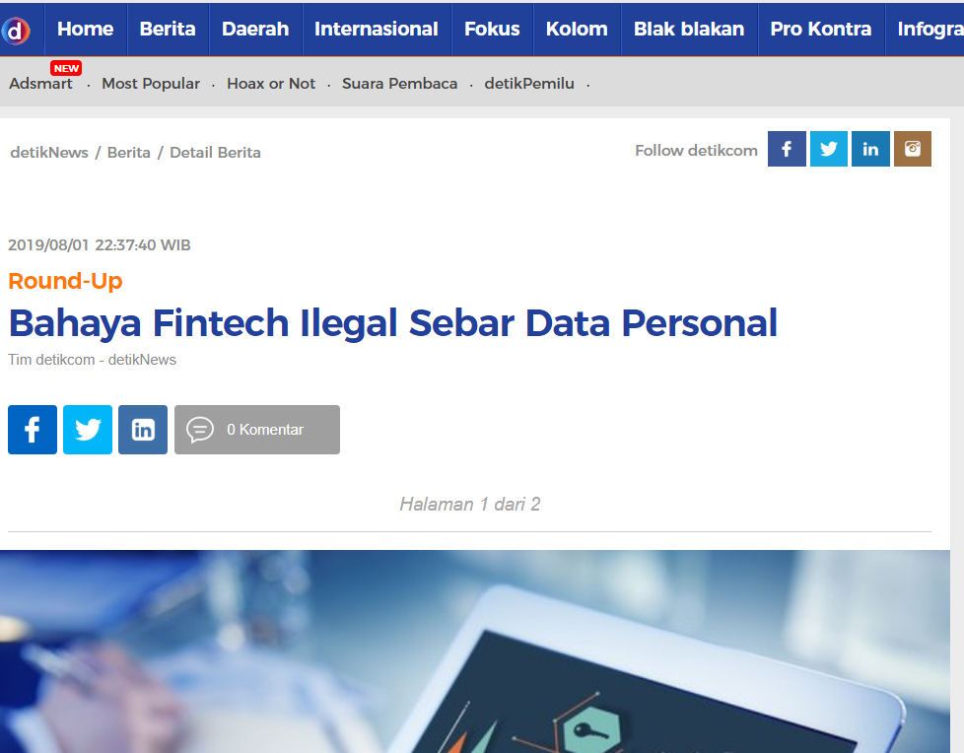
Sonny Zulhuda (c) 2019

Slide 18
CONCLUDING REMARKS
Innovation shall remain sustainable: Fintech today, more tomorrow!
In anticipating the Internet, AI an blockchain technology, Law needs to be disruptive, leaving its traditional limitations as much as possible
In the backbone of the innovation is DATA including trade secrets, IPR and personal data. These areas cannot be let without rules of the game.
With so much data and interest at stake on Fintech, Trust Governance is another critical prerequisite.
One step at a time, empowerment of financial technology will enable us to achieve the objectives of the Shariah (maqasidic view) which favours a more inclusive financial system, responsible humanity and achievement of the meaning of the vicegerence of God.
Sonny Zulhuda (c) 2019

Slide 19

THANK YOU
DR SONNY ZULHUDA
sonny@iium.edu.my
sonnyzulhuda.com

